Slide 1

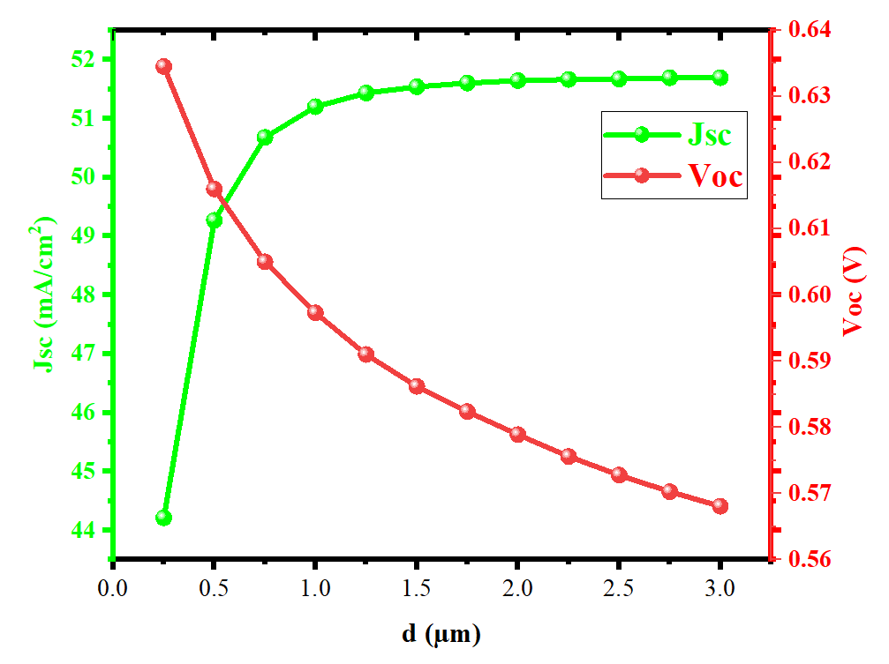
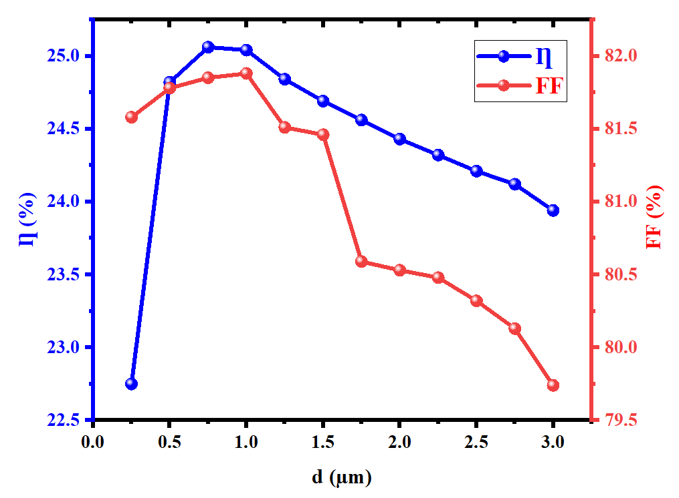
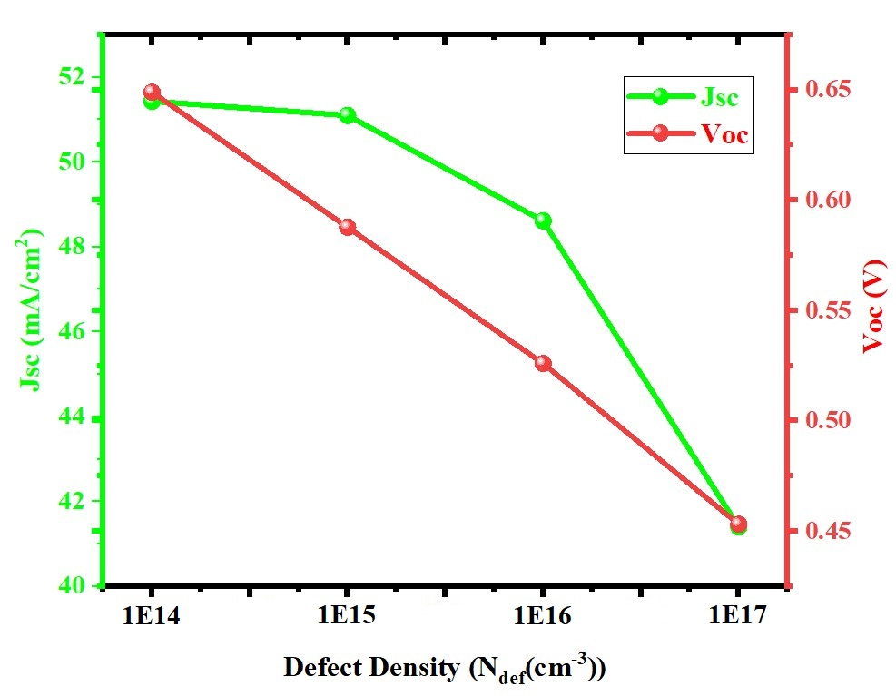
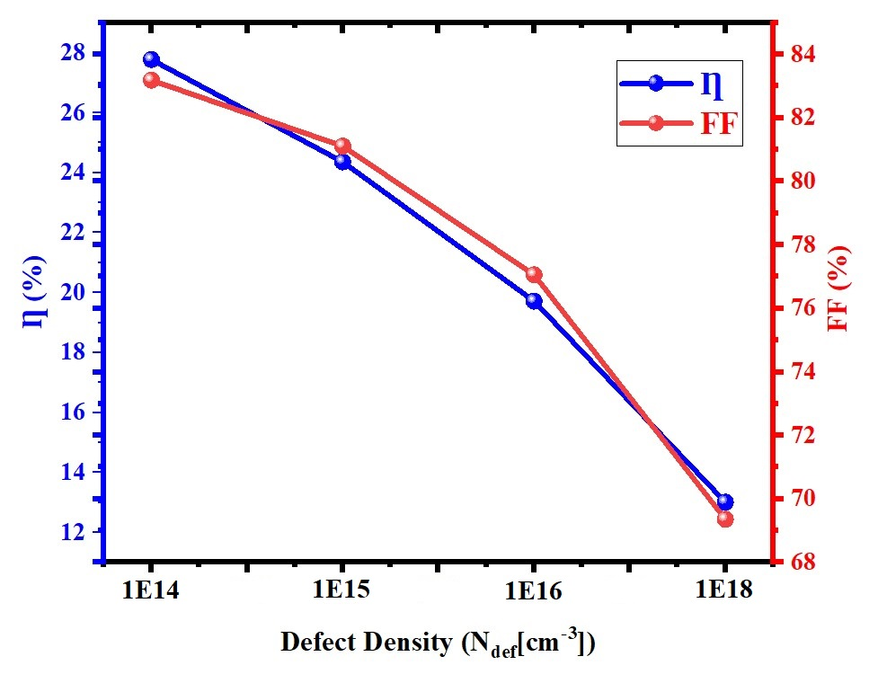
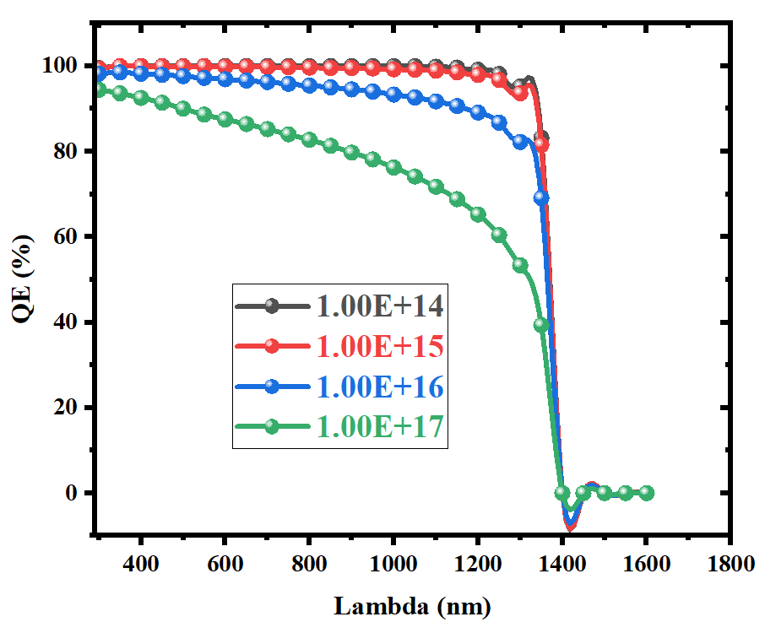
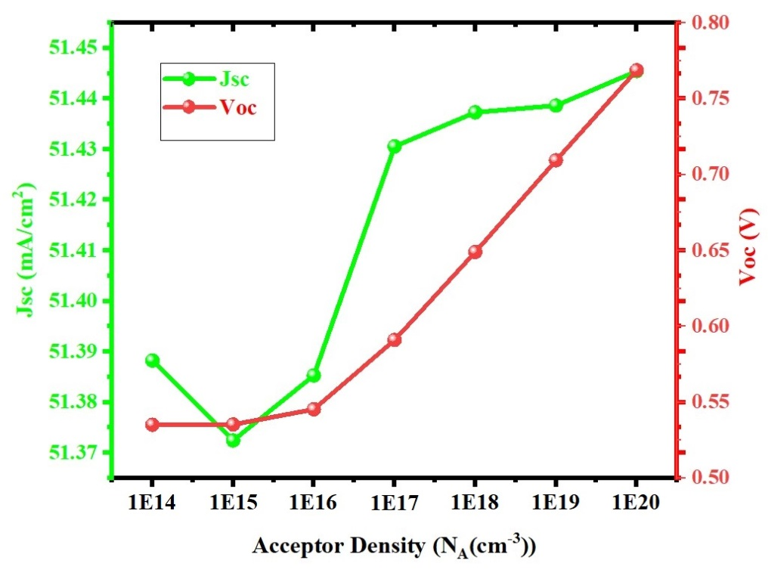
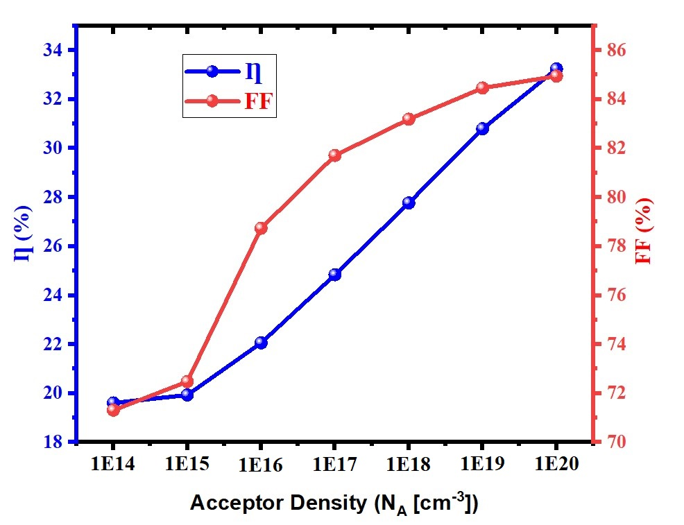
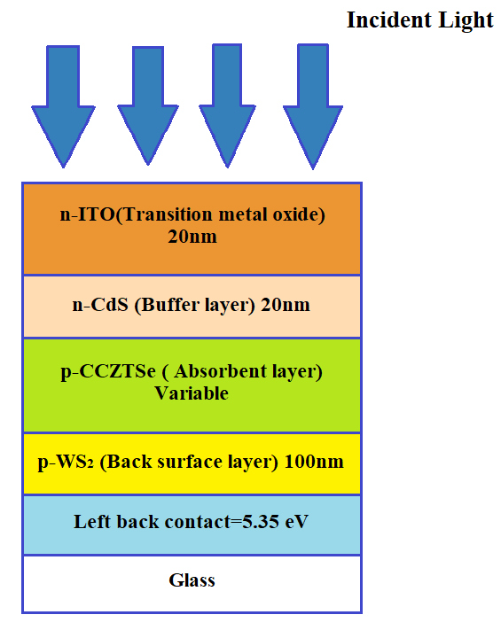
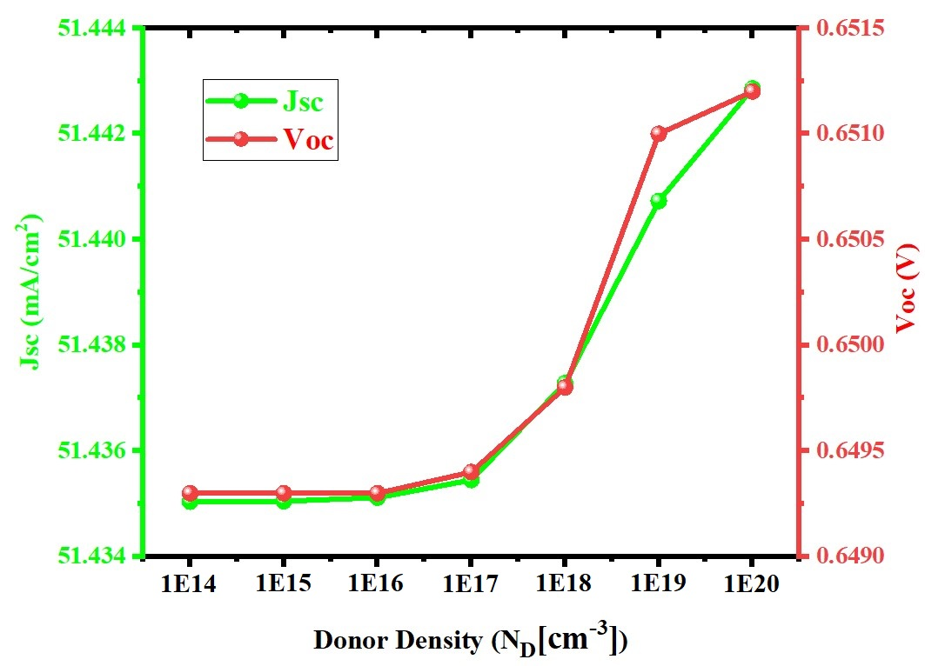
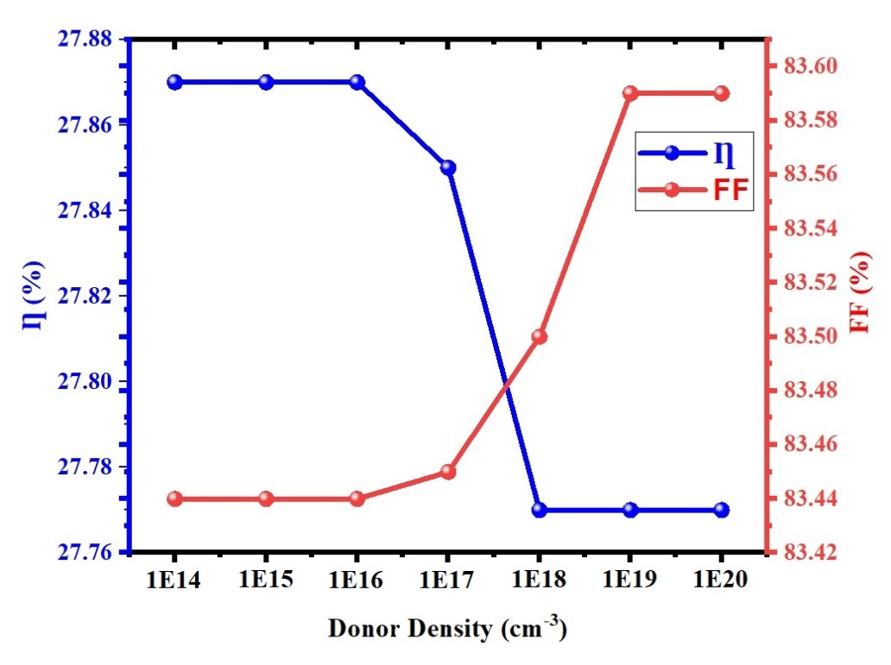
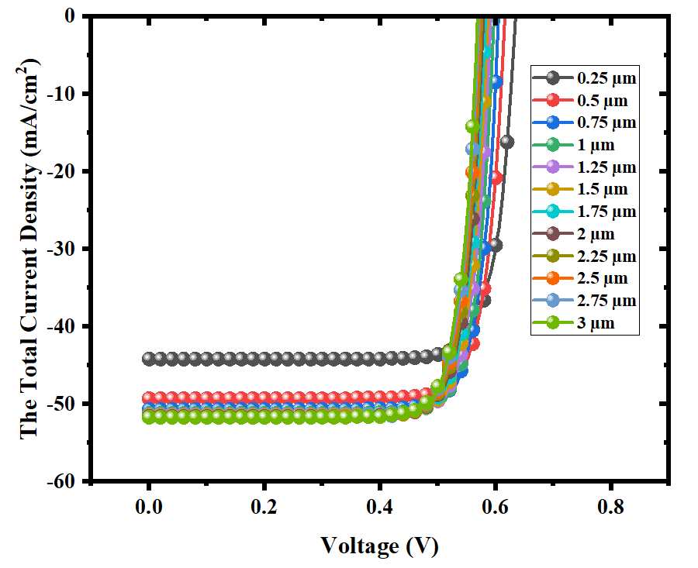
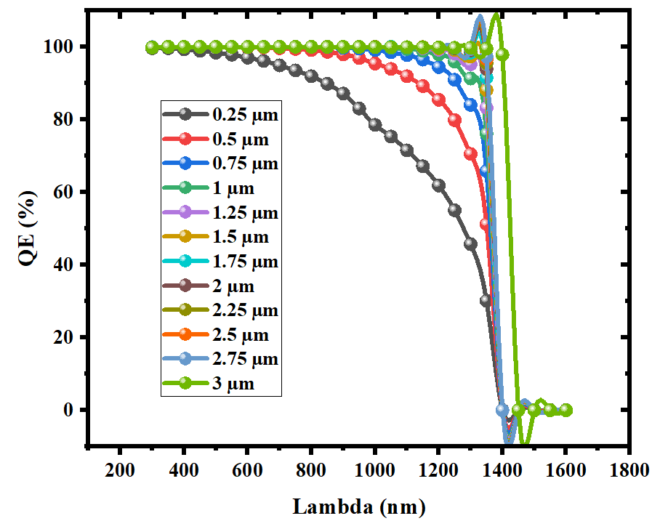
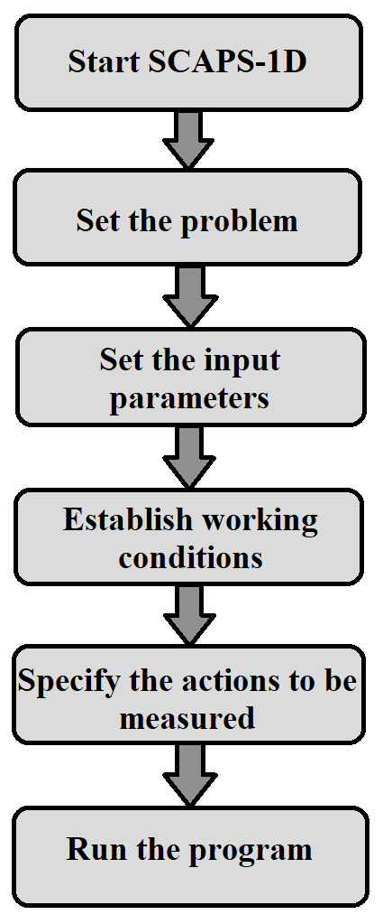
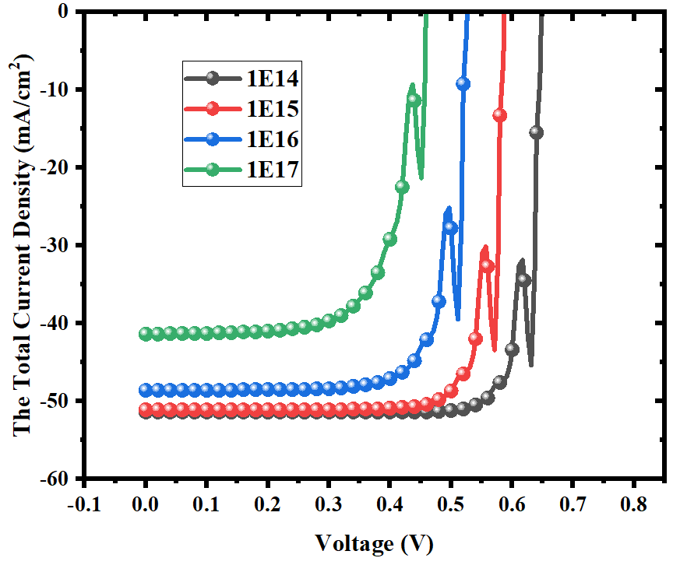
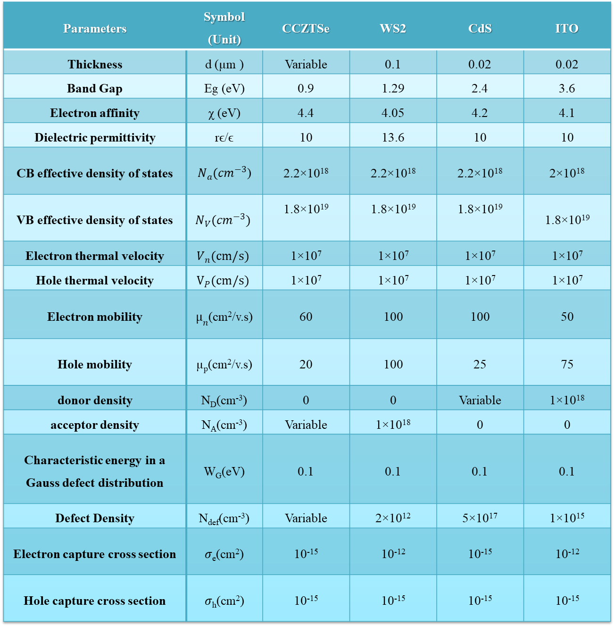
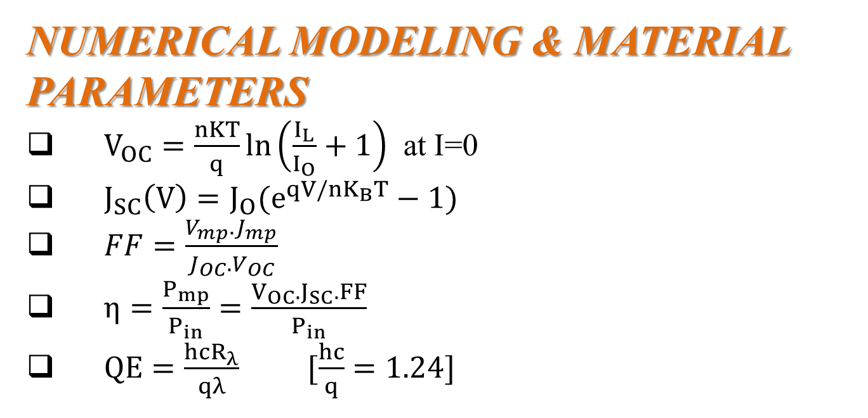
Simulation of Thin-Film Solar Cells based on (CCZTSe) Using (SCAPS-1D) Program
SUPERVISOR’S NAME: Shovon Talukder, Lecturer, EEE, EWU
Rohit Bhowmick ID: 2020-1-80-006
Department Of EEE
ABSTRACT
Demonstrated that altering the CCZTSe layer thickness led to an enhancement in the conversion efficiency (η).
Increasing the acceptor concentration (N_{A}) in the CCZTSe absorption layer leads to efficiency (η) improvement from roughly.
The donor density (N_{D}) in the CdS buffer layer didn’t induce any noticeable changes.
The temperature & defects densities (N_{def}) ranging lead to an efficiency drop.
NUMERICAL MODELING & MATERIAL PARAMETERS
$V_{OC}=\frac{nKT}{q}\ln\left(\frac{I_{L}}{I_{O}}+1\right)$ at I=0
$J_{SC}\left(V\right)=J_{O}(e^{qV/nK_{B}T}−1)$
$FF=\frac{V_{mp}.J_{mp}}{J_{OC}.V_{OC}}$
$η=\frac{P_{mp}}{P_{in}}=\frac{V_{OC}.J_{SC}.FF}{P_{in}}$
$QE=\frac{hcR_{λ}}{qλ} [\frac{hc}{q}=1.24]$
OBJECTIVE
Characterized by the use of thin semiconductor layers to absorb and convert sunlight into electricity.
CCZTSe is a type of semiconductor material that has shown promise for photovoltaic applications due to its potential for efficient light absorption and energy conversion.
The aim to achieve the high efficiency photovoltaic cell by manipulating the absorber layer thickness and defect density, exploring their influence on the overall performance of the solar cell.
PARAMETER
Figure 05: Effect of the Thickness of the p-CCZTSe absorption layer on the open circuit voltage (V_{OC}) and current density (J_{SC})
Figure 06: Effect of the Thickness of the p-CCZTSe absorption layer on the efficiency value (Ƞ) and fill factor (FF)
Figure 12: Effect of the defect density in the p-CCZTSe absorption layer on V_{OC} and J_{SC}
Figure 13: Effect of the defect density of the p-CCZTSe adsorption layer on the efficiency value (Ƞ) and fill factor (FF)
Table 01: The main parameters of the solar cell (CCZTSe)
Parameters | Symbol (Unit) | CCZTSe | WS2 | CdS | ITO
Thickness | d (µm ) | Variable | 0.1 | 0.02 | 0.02
Band Gap | Eg (eV) | 0.9 | 1.29 | 2.4 | 3.6
Electron affinity | χ (eV) | 4.4 | 4.05 | 4.2 | 4.1
Dielectric permittivity | rϵ/ϵ | 10 | 13.6 | 10 | 10
CB effective density of states | $N_{a}({cm}^{−3}$) | 2.2×10¹⁸ | 2.2×10¹⁸ | 2.2×10¹⁸ | 2×10¹⁸
VB effective density of states | $$N_{V}({cm}^{−3})$$ | 1.8×10¹⁹ | 1.8×10¹⁹ | 1.8×10¹⁹ | 1.8×10¹⁹
Electron thermal velocity | $$V_{n}(cm/s)$$ | 1×10⁷ | 1×10⁷ | 1×10⁷ | 1×10⁷
Hole thermal velocity | $$V_{P}(cm/s)$$ | 1×10⁷ | 1×10⁷ | 1×10⁷ | 1×10⁷
Electron mobility | $µ_{n}$(cm²/v.s) | 60 | 100 | 100 | 50
Hole mobility | µ_{p}(cm²/v.s) | 20 | 100 | 25 | 75
donor density | N_{D}(cm⁻³) | 0 | 0 | Variable | 1×10¹⁸
acceptor density | N_{A}(cm⁻³) | Variable | 1×10¹⁸ | 0 | 0
Characteristic energy in a Gauss defect distribution | W_{G}(eV) | 0.1 | 0.1 | 0.1 | 0.1
Defect Density | N_{def}(cm⁻³) | Variable | 2×10¹² | 5×10¹⁷ | 1×10¹⁵
Electron capture cross section | 𝜎_{e}(cm²) | 10⁻¹⁵ | 10⁻¹² | 10⁻¹⁵ | 10⁻¹²
Hole capture cross section | 𝜎_{h}(cm²) | 10⁻¹⁵ | 10⁻¹⁵ | 10⁻¹⁵ | 10⁻¹⁵
Effect of Acceptor Concentration
Figure 14: Effect of defect density (N_{def}) on the Quantum efficiency (QE)
INTRODUCTION
Solar cells play a crucial role by directly converting sunlight into electrical energy.
The use of a Thin-Film (CCZTSe) solar cell to achieve both high efficiency and cost-effectiveness.
The presence of impurities can potentially lower the conversion efficiency of the solar cell.
The simulation software (SCAPS-1D) to investigate a photovoltaic cell composed of a (ZNO) window layer, a (CCZTSe) absorption layer, and a (CdS) buffer layer.
Effect of changing temperature
Figure 07: Effect of Acceptor Concentration in the absorption layer on the current density (J_{SC}) and open circuit voltage (V_{OC})
Figure 08: Effect of Acceptor Concentration in the absorption layer on cell efficiency (Ƞ) and filling factor (FF)
Table 2: Interface Gaussian Defect States of the solar cell (CCZTSe)
Effect of Donor Concentration
Figure 15: Effect of the Temperature in the p-CCZTSe based solar cell on V_{OC} and J_{SC}
Figure 16: Effect of the Temperature in the p-CCZTSe based solar cell on the efficiency value (Ƞ) and fill factor (FF)
Parameters | Symbol (Unit) | CCZTSe/CdS
Gaussian defect density | N_{t}(cm⁻³) | 1×10¹⁵
Electron capture cross section | 𝜎_{e}(cm²) | 1×10⁻¹⁶
Electron capture cross section | 𝜎_{h}(cm²) | 1×10⁻¹⁵
Figure 01: Solar cell installation construction WS₂+CCZTSe+CdS+ITO
PHYSICS
Defects
CONCLUSION
The study highlights CCZTSe's potential for solar cells while emphasizing the importance of optimizing material properties to enhance performance.
Efficiency was found to be promising under certain conditions. However, challenges like material quality and interface engineering need attention for practical application.
RESULTS AND DISCUSSION:
Increasing defects means a reduction in the diffusion length of the charge carriers and the addition of recombination carriers in the absorber layer
Elevated defect density within the absorber layer of solar cells has been identified as a leading cause for reduced cell performance. As defect density rises, the quantum efficiency of the cells diminishes
Effect of changing the thickness of the absorbent layer
Figure 09: Effect of donor concentration (N_{D}) in the n-CdS layer on V_{OC} and J_{SC}
Figure 10: Effect of the donor concentration (ND) in the n-CdS layer on the cell efficiency (Ƞ) and the filling factor (FF)
INSTRUCTION TO SIMULATE SCAPS-1D
Effect of defects density in the absorbent layer
Figure 11: Effect of defect density in p-CCZTSe absorption layer on the I-V curve
Temperature
Figure 02: Steps to build and simulate a solar cell in SCAPS -1D
Increase in temperature affects the semiconductor material parameters by increasing the energy of bound electrons. This means that the energy difference to achieve the exited state is smaller, which results in reduced power output and efficiency of solar panels
Figure 03: Effect of the Thickness of the p-CCZTSe absorption layer on the (I-V) curve
Figure 04: Effect of Thickness on Quantum-efficiency (QE) Curve
FUTURE PLANS
We'll try to figure out the acceptor density, donor density, temperature, defect density for different layers for better efficiency

